Slide 1
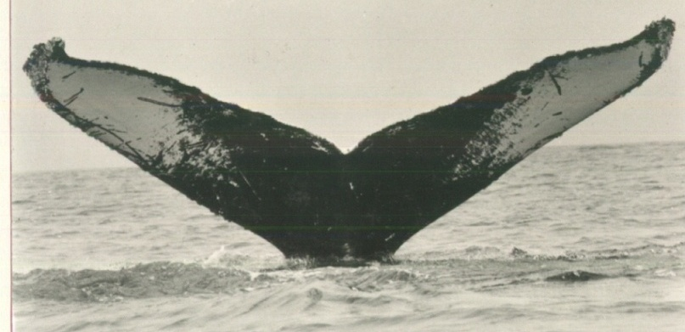
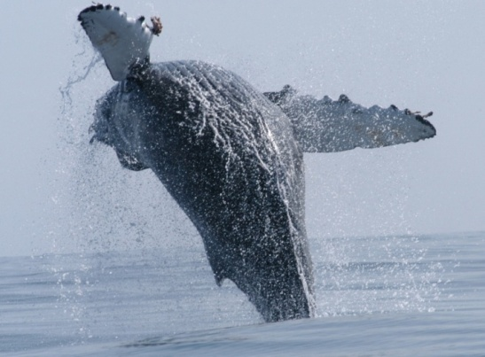
Humpback whales along the US West Coast and relationship to entanglements
John Calambokidis
Cascadia Research
Support over the years from Sanctuaries, NOAA-Fisheries, SWFSC, Pacific Life, and other sources

Slide 2
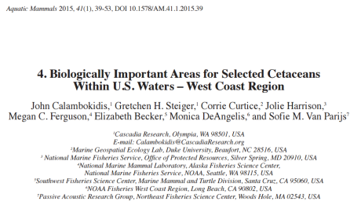
Humpback whale Biologically Important Feeding Areas

Slide 3
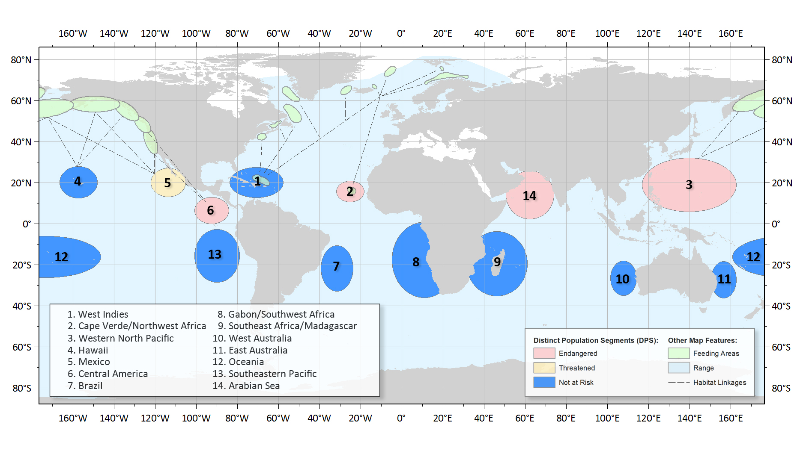
New ESA status of humpback whales

Slide 4
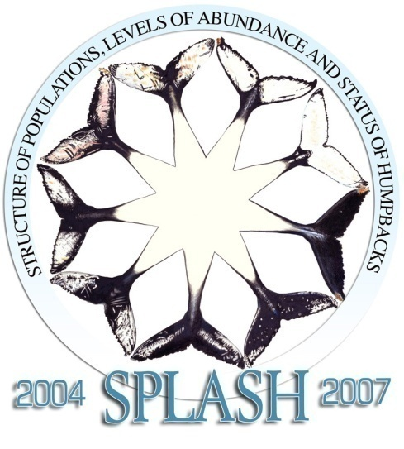
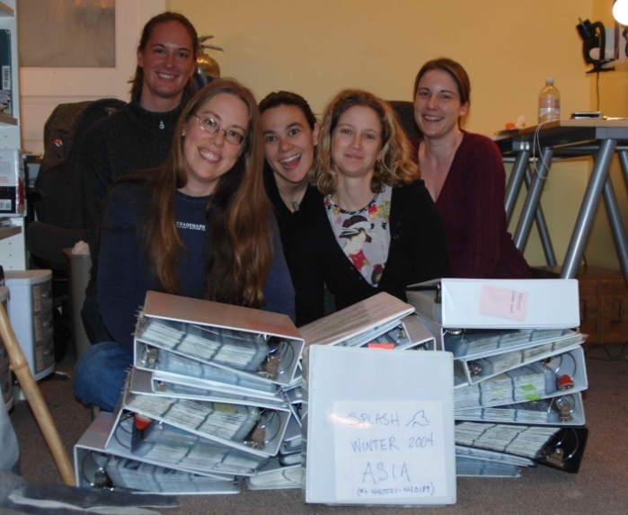
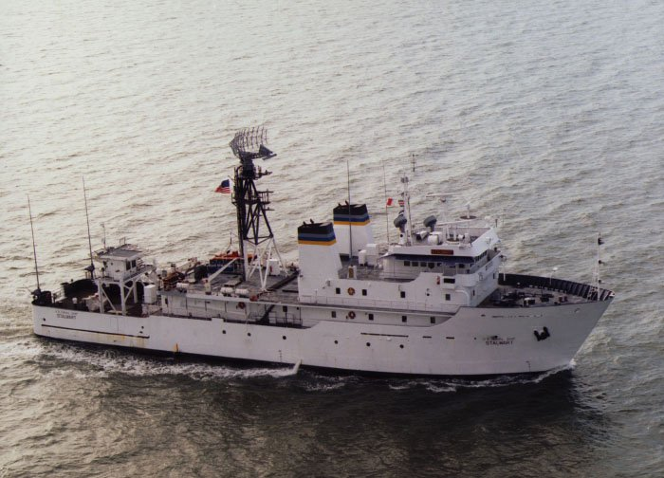
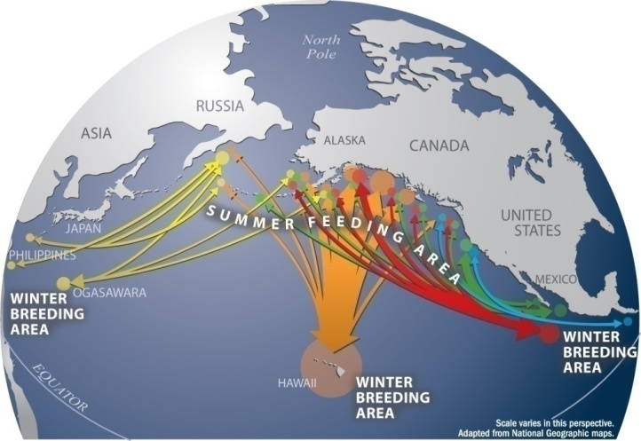
SPLASH
Structure of Populations, Levels of Abundance, and Status of Humpbacks
Abundance and Trends:
  Photo identification
  Mark-recapture abundance
Population stock structure
  Movement (photo-ID)
  Genetic studies
Human-caused injuries
  Fishery interactions
  Vessel collisions
Largest collaborative study on whales
Over 400 participants and 50 organizations
Efforts in 10 countries throughout N Pacific
Notes:
4

Slide 5
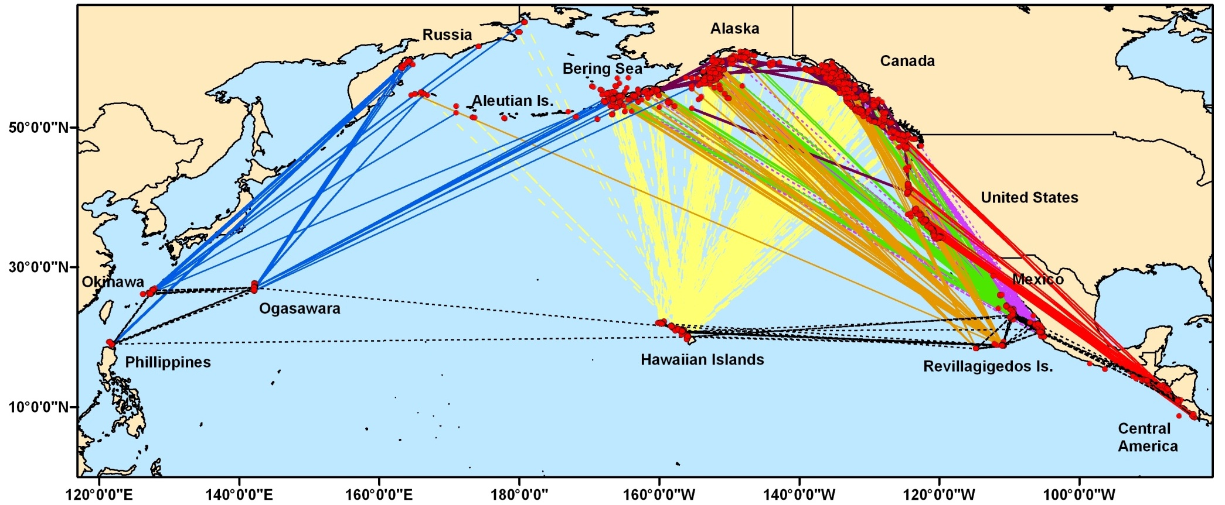

Humpback whale population structure
Based on results from SPLASH

Slide 6
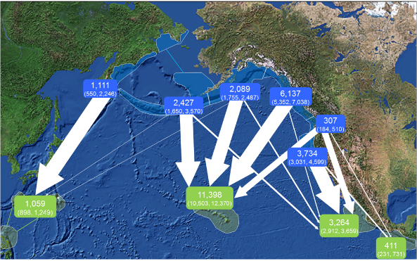
SPLASH multi-strata estimates (Wade et al.)

Slide 7
Interchange based on 6 feeding/wintering areas
 |  | Breeding Area
 |  | 1 | 2 | 3 | 4 | 5 | 6
Feeding Area |  | Cental Am | Mx Mainld | Mx Baja | Mx Islands | Hawaii | West Pac
1 | CA&OR | 26 | 89 | 16
2 | NWA&SBC | 3 | 18 | 7 | 2 | 18
3 | NBC&SEAK |  | 11 | 8 | 16 | 291
4 | GOA |  | 25 | 22 | 50 | 150 | 2
5 | Aleut.&Bering |  | 9 | 7 | 11 | 50 | 9
6 | Kamchatka |  |  |  |  |  | 21

Slide 8
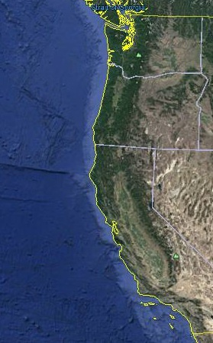
Proportion of humpback whales matching breeding areas

Slide 9
Proportion of humpback whales identified or sighted in different regions along the US West Coast matching Central America

Slide 10
8 breeding grounds
N = 825
2.5:1 males:females
F_{ST} = 0.105; p < 0.0001
Males F_{ST} = 0.124; p < 0.0001
Females F_{ST} = 0.087; p < 0.0001
Okinawa
N = 78
Mexico Mainland
N = 63
Mexico Baja
N = 118
Ogasawara
N = 173
Mexico AR
N = 115
Philippines
N = 13
Hawaii
N = 229
Central America
N = 37
Notes:
So first to the breeding grounds,
For these 8 regions, our analysis includes 817 samples, with a sex ratio of about 2.5 males to 1 female. This male-biased sex ratio is similar to that found previously in biopsy samples from winter breeding grounds.
We achieved the goal of 100 samples per region from the three Mexican regions: Mainland, Baja and Revillagigedo Islands, as well as Ogasawara and Okinawa, with a larger sample from Hawaii.
The goal of 100 samples was not possible for Central America or the Philippines, even when using samples from all years combined.
Although there was sharing of the 4 common haplotypes across most regions, overall differences among the 8 breeding grounds were highly significant with an Fst = 0.105

Slide 11
7 feeding ‘stocks’
N Gulf of Alaska
Bering Sea
SE Alaska/
NBC
Russia
W Gulf of Alaska
E Aleutians
SBC/ Washington
dashed lines separate regions that differ significantly
arrow connect regions that are NOT different
  Bering and W Aleutian
  W Aleutian and W Gulf of Alaska
  SE Alaska and N British Colombia
California/Oregon

Slide 12
Transition in mtDNA haplotypes by latitude (SPLASH)

Slide 13
Transition in mtDNA haplotypes by latitude (SPLASH)
CA-OR
WA-SBC
NBC
SEAK

Slide 14
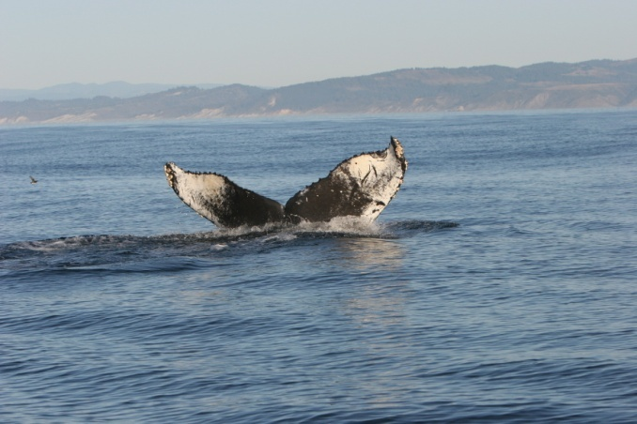
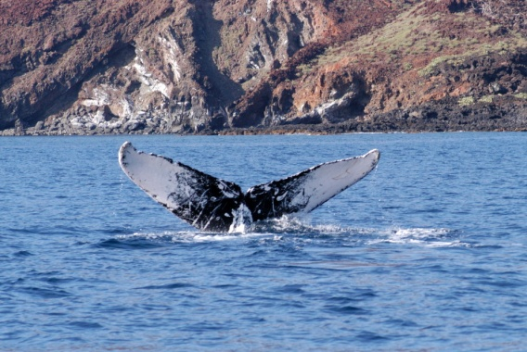
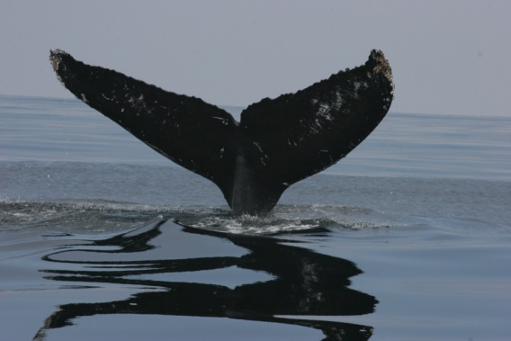
Match rate to US West Coast
Photo: Jeff Jacobsen
Photo: Jeff Jacobsen
Photo: John Calambokidis
Notes:
14

Slide 15
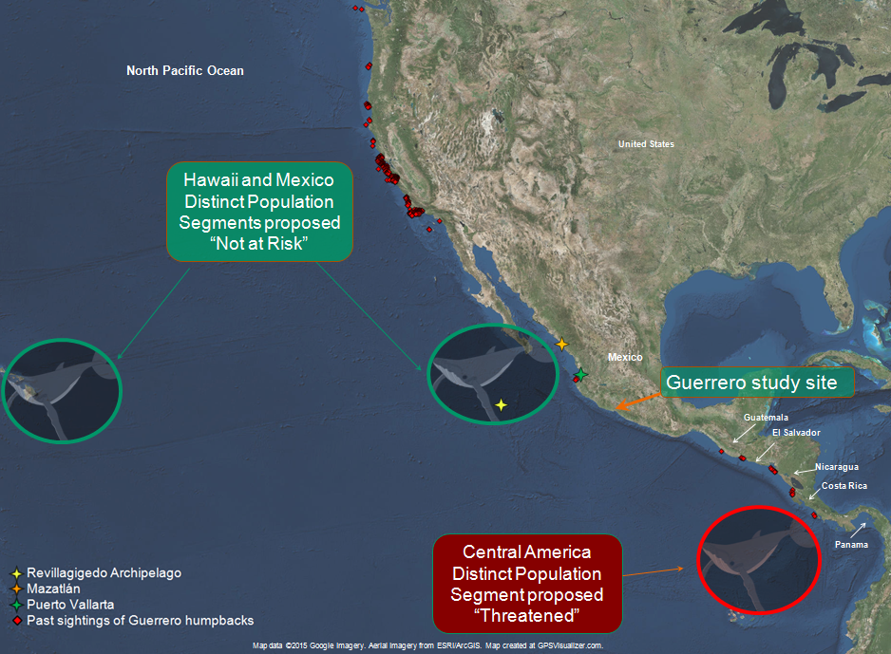
Red diamonds show sighting location histories of all identified Guerrero whales from 1987 through 2014. The rings represent three of the proposed Distinct Population Segments, based on breeding grounds of humpback whales in the Eastern North Pacific.

Slide 16
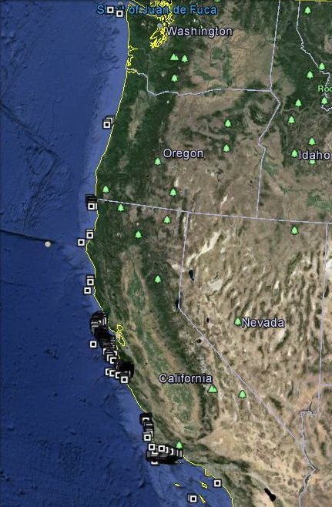
Locations of resightings of humpback whales identified in
S Mexico

Slide 17
Proportion of matches to different regions of the West Coast

Slide 18
Humpback whale trends – California and Oregon

Slide 19
Estimates of humpback whale abundance off WA - SBC

Slide 20
Likely responses to reaching carrying capacity
Greater nutritional stress and dependence on prey dynamics especially at the end of seasonal fasts
Expansion into more peripheral habitats and feeding time periods
Greater time expended feeding and emphasis on feeding over breeding
Increased mortality
  At the end of seasonal fasts
  In more vulnerable age classes
  Where expanded timing or areas of use cause greater exposure or vulnerability to other factors

Slide 21
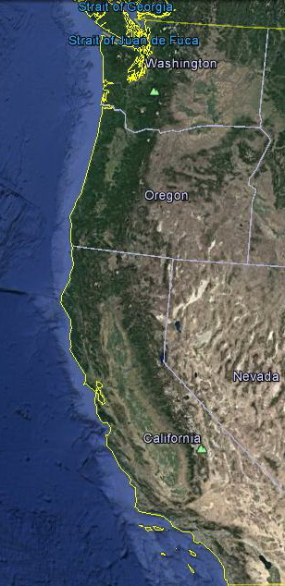
Areas of recent expansion of humpback whale occurrence
Salish Sea
SF Bay
S California Bight

Slide 22
Increased sighting reports of humpback whales in Salish Sea

Slide 23
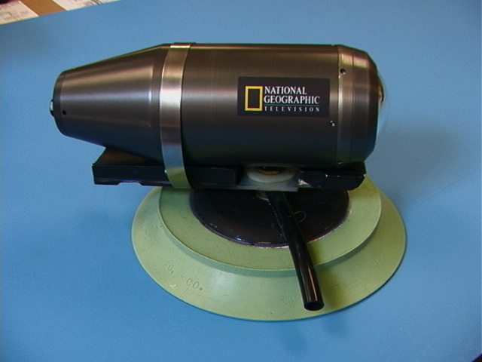
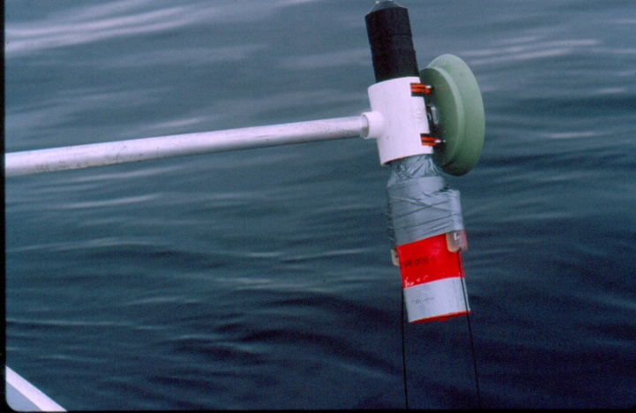
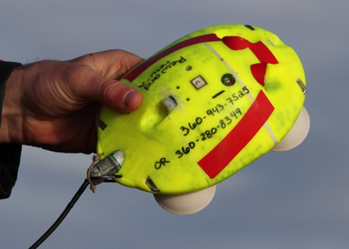
Initial tag types deployed
National Geographic Crittercam
  video, sound, depth, temperature
Acoustic tags
  digital sound, temperature, pitch and roll angle, VHF, & satellite
WHOI dTag
  digital sound, temperature, accelerometers and magnetometers
Multi-sensor video tags

Slide 24
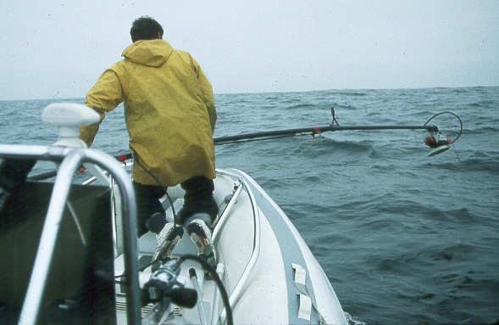
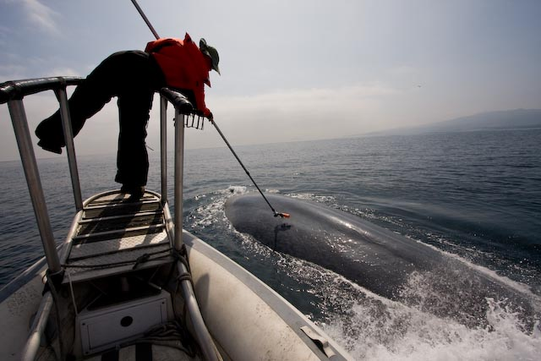
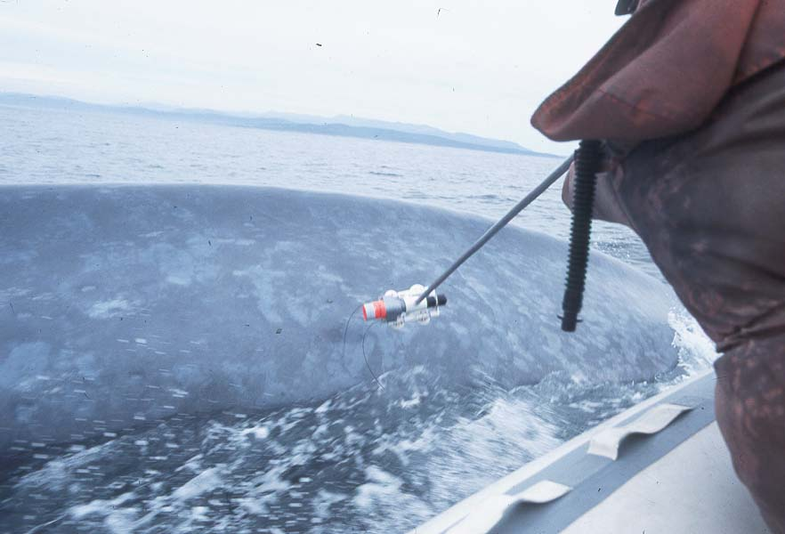
Tagging
Species: Blue, fin, humpback, sperm whale, Risso’s dolphin
Regions: Cent Am, Mex, California, Alaska
Tags: Bprobe, Crittercam, FastLok GPS, Dtag. Video tag
Deployment:
  Pressed on with pole
  1-4 suction cups
  Different releases

Slide 25
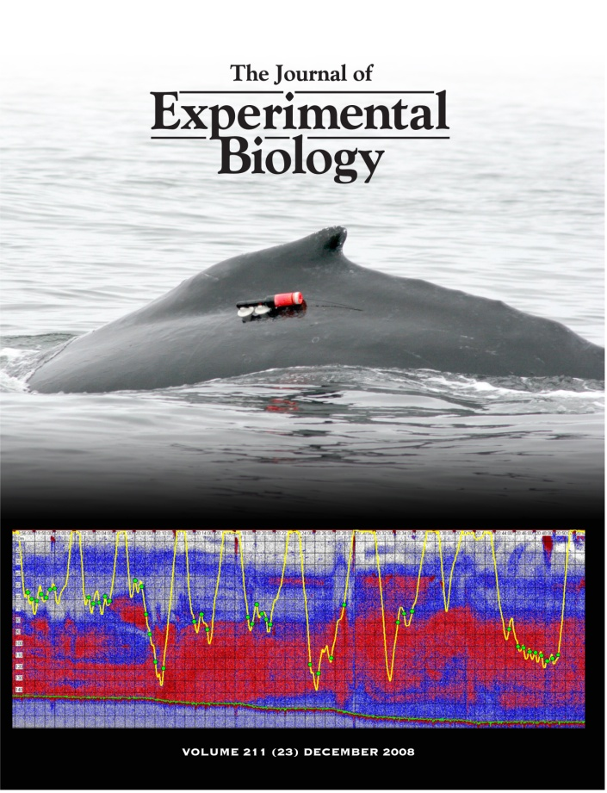
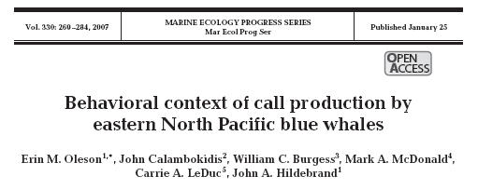
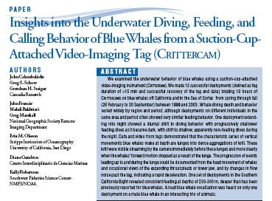
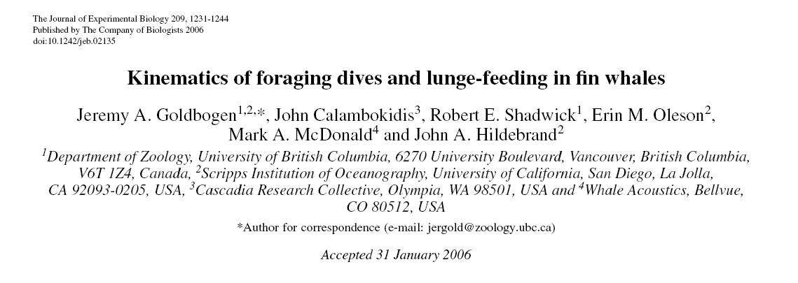
Publications on underwater behavior of blue, fin, and humpback whales

Slide 26
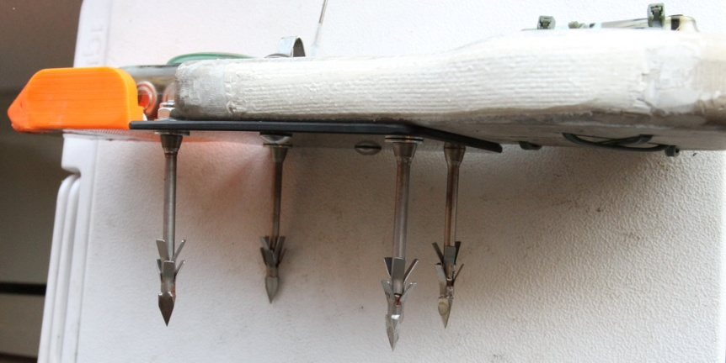
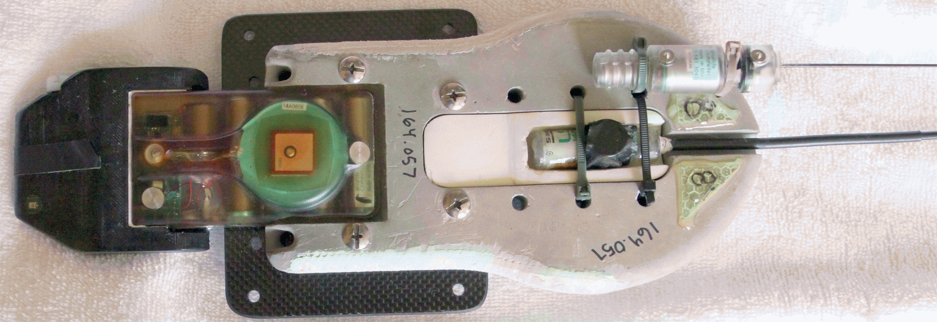
Medium duration dart-attached GPS archival tag
Dart-attached archival tag for medium duration sampling of GPS position and high resolution underwater behavior
Surgical stainless darts designed after LIMPET titanium darts
CATS PAD high sample rate 3D
Acceler., Magnetmtr., and Gyro
ATS VHF transmitter
Wildlife Computers TDR10F
Fast Lock GPS tag
Wildlife Computers
SPOT 6 satellite transmitter
Photo taken under U.S. NMFS permit # 14534

Slide 27
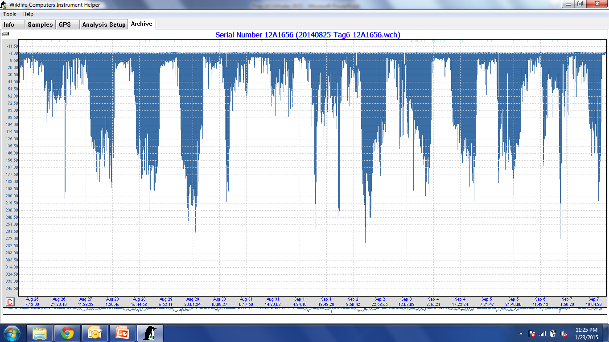
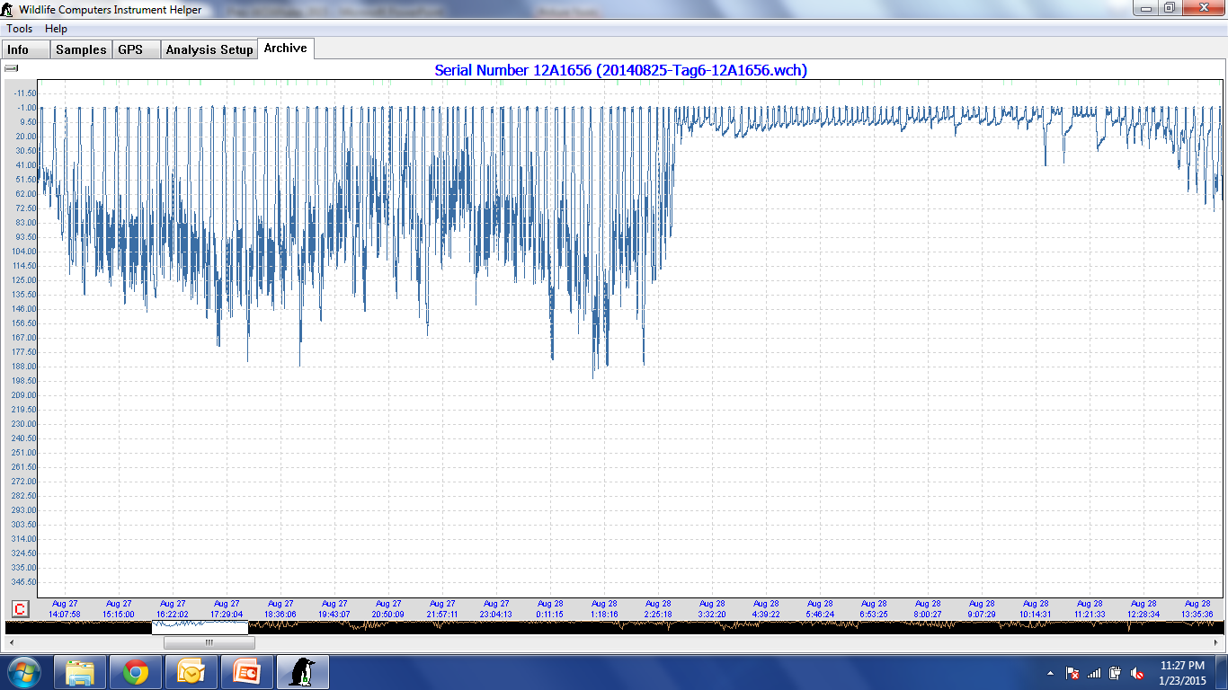
Dive record from 13 day archival tag deployment showing day night differences
13 d showing alternating day-night diving pattern
24 h period from above showing day then night diving behavior

Slide 28
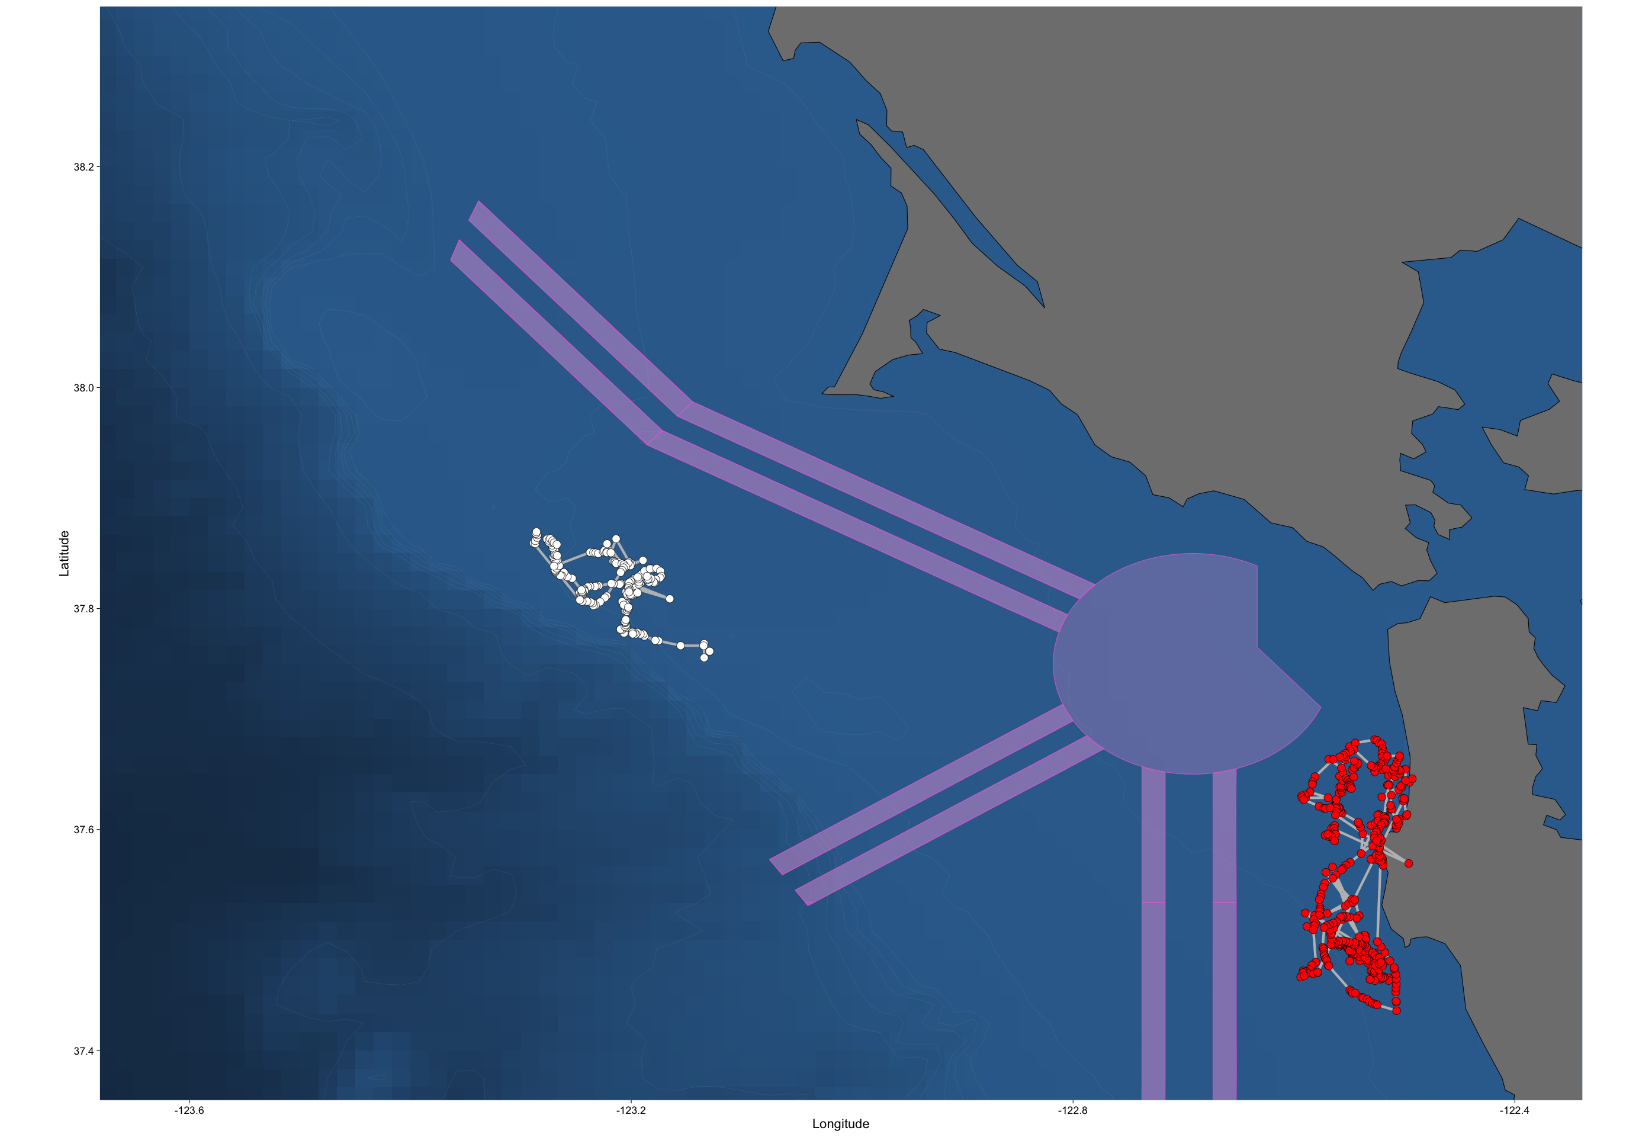
Track of two humpback whales off the Bay area in 2016 from dart-attached TDR-10 tags

Slide 29
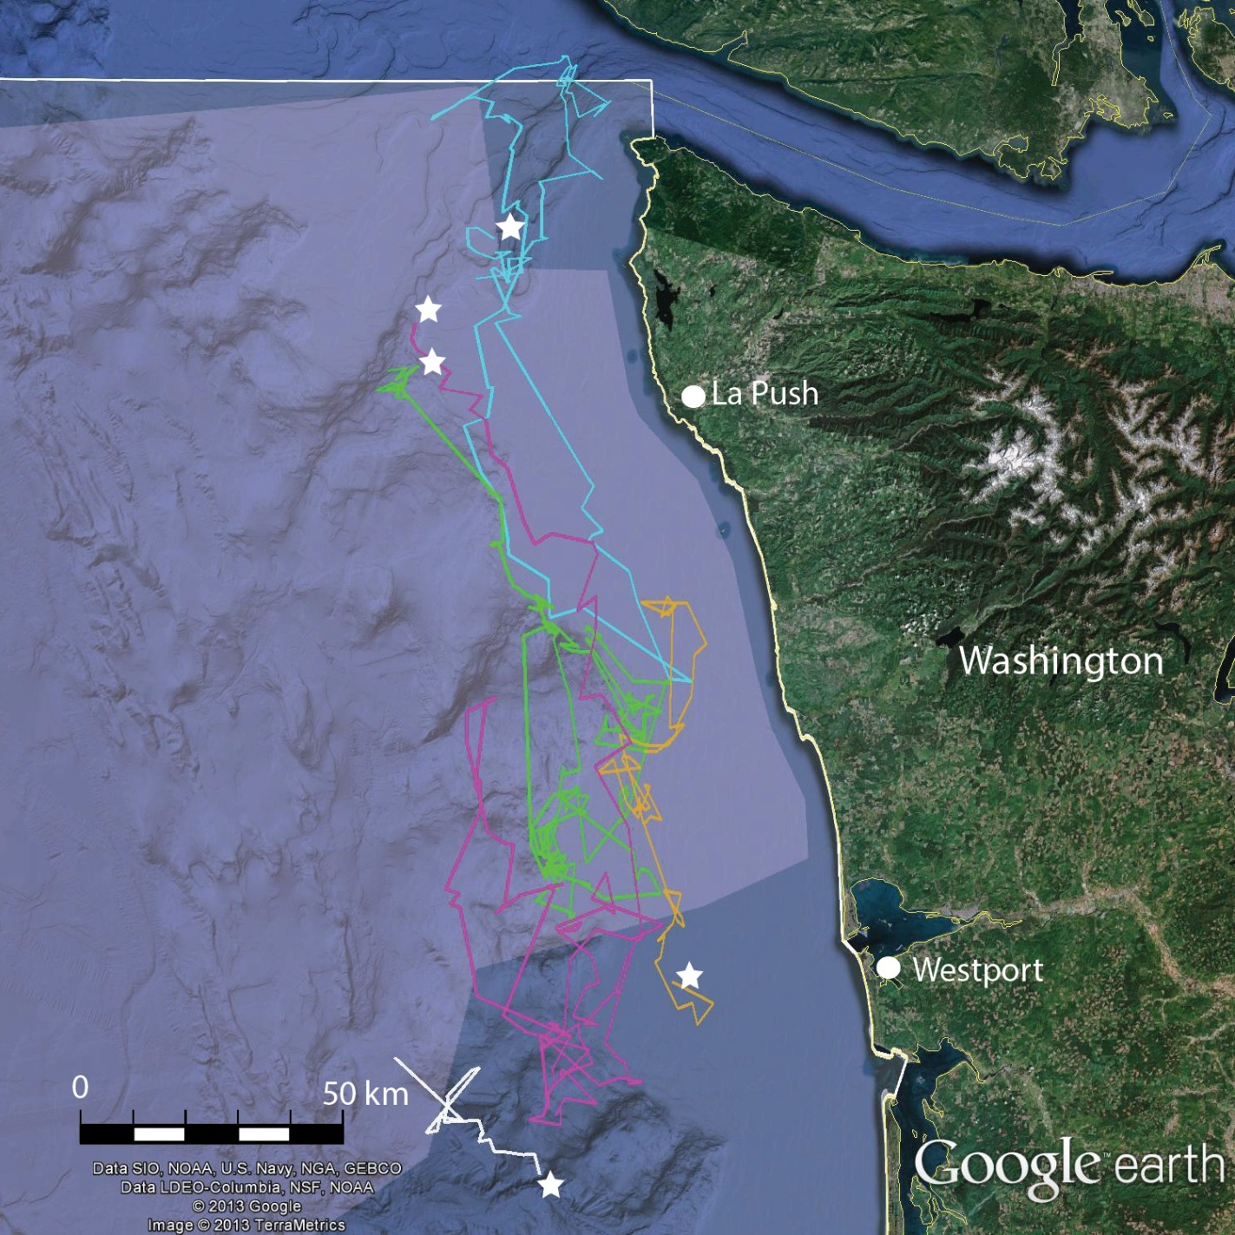
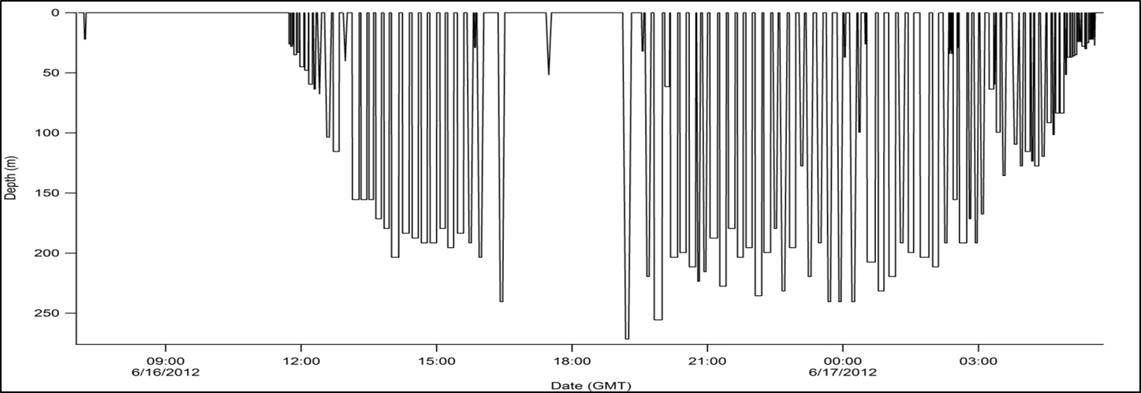
Results from five LIMPET tags on humpback whales off WA

Slide 30
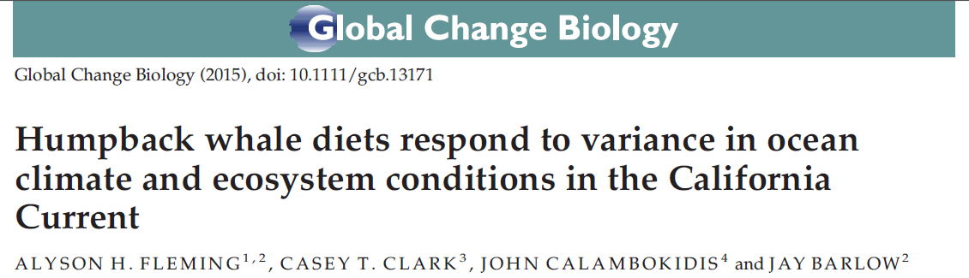
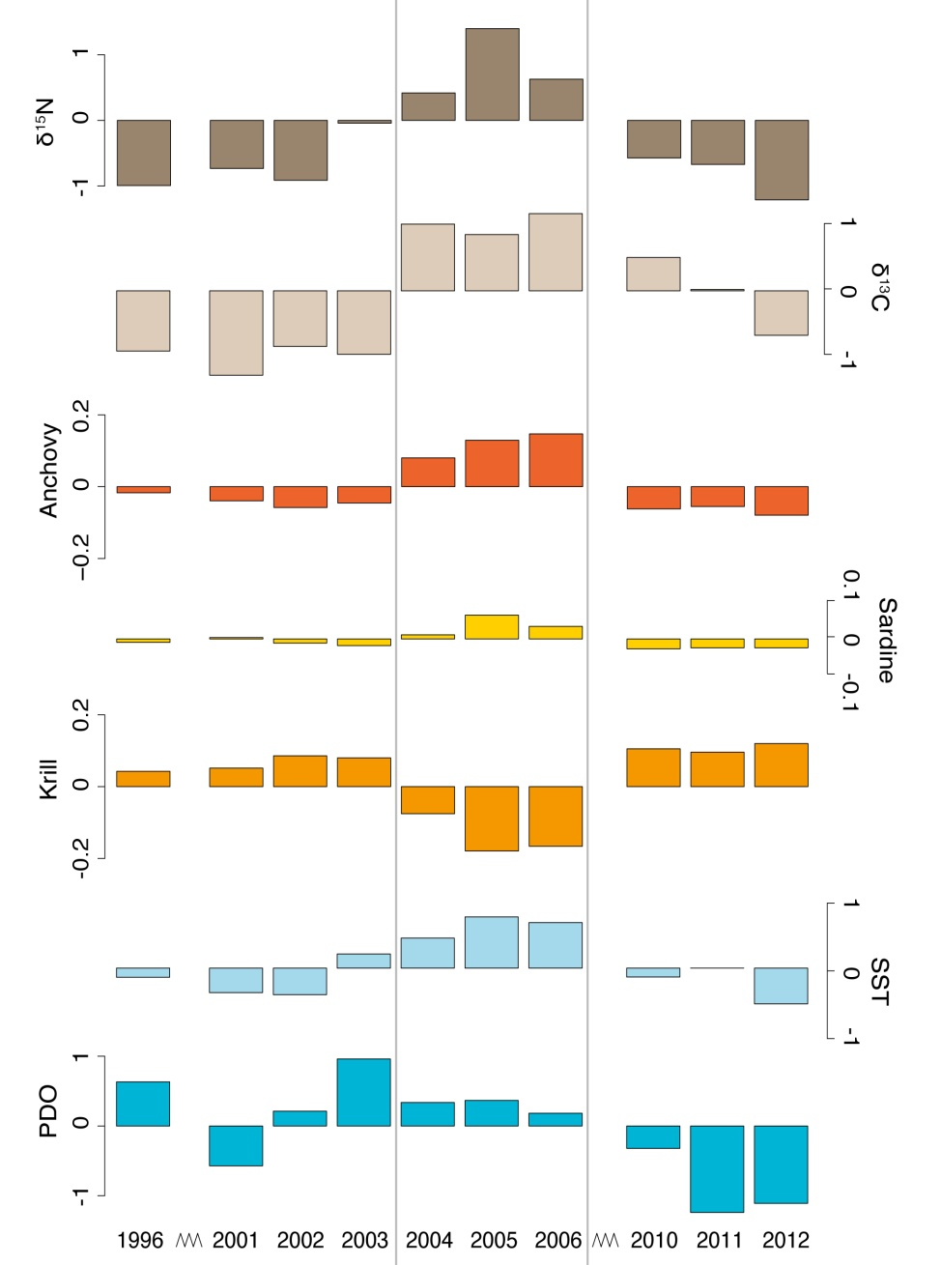
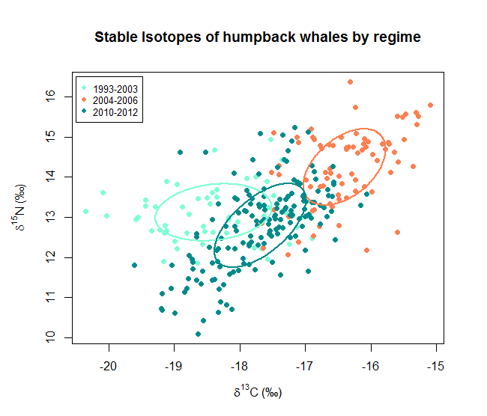
Humpback whales switch prey in changing conditions
Shifts in distribution with prey:
Krill feeding concentrated near shelf edge
Fish feeding closer to shore/shallower
Flemming et al. 2015
Notes:
30

Slide 31
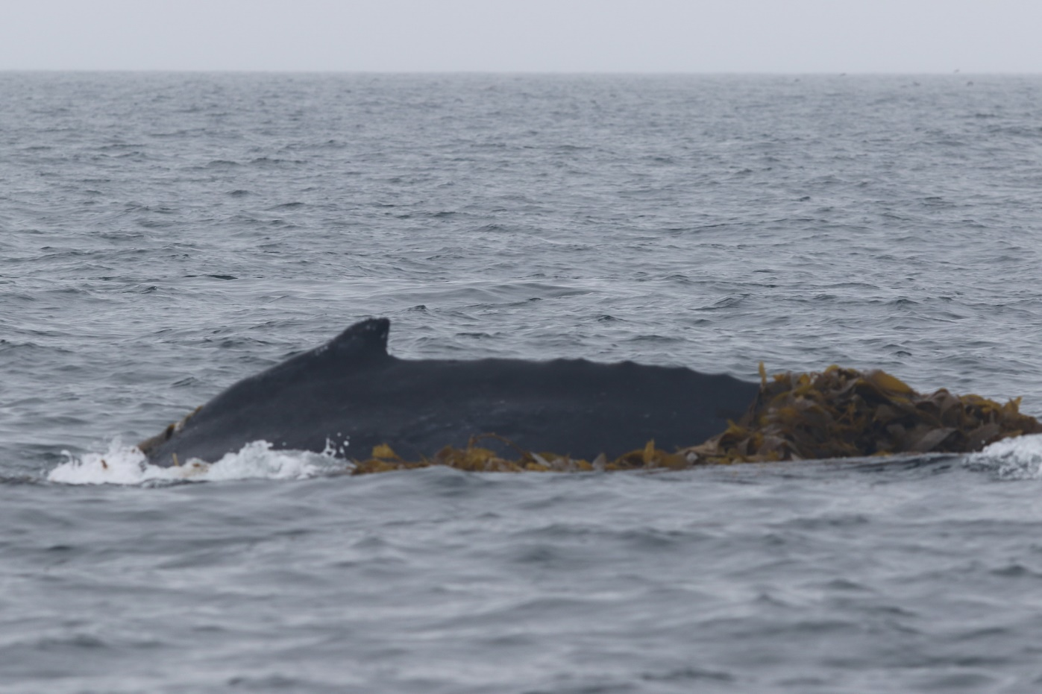
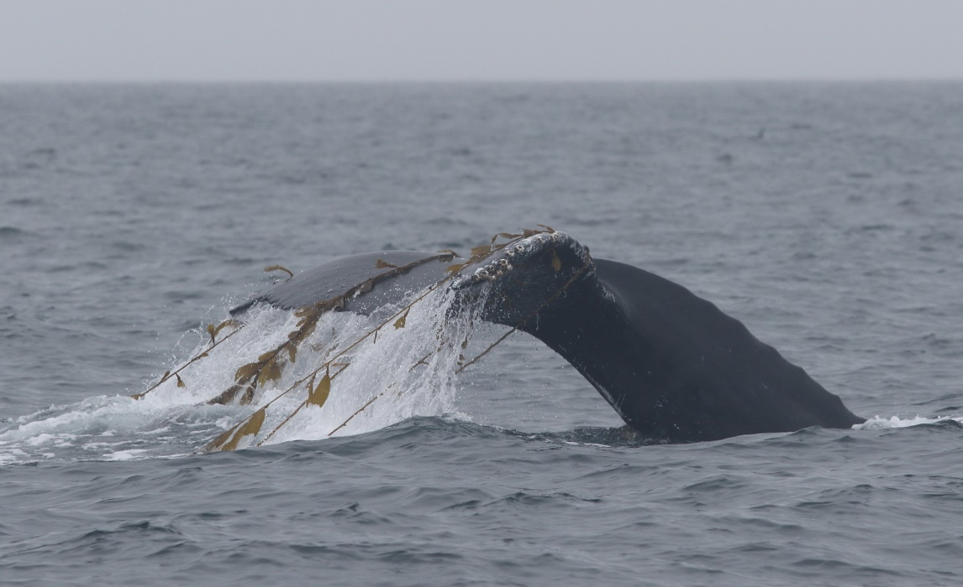
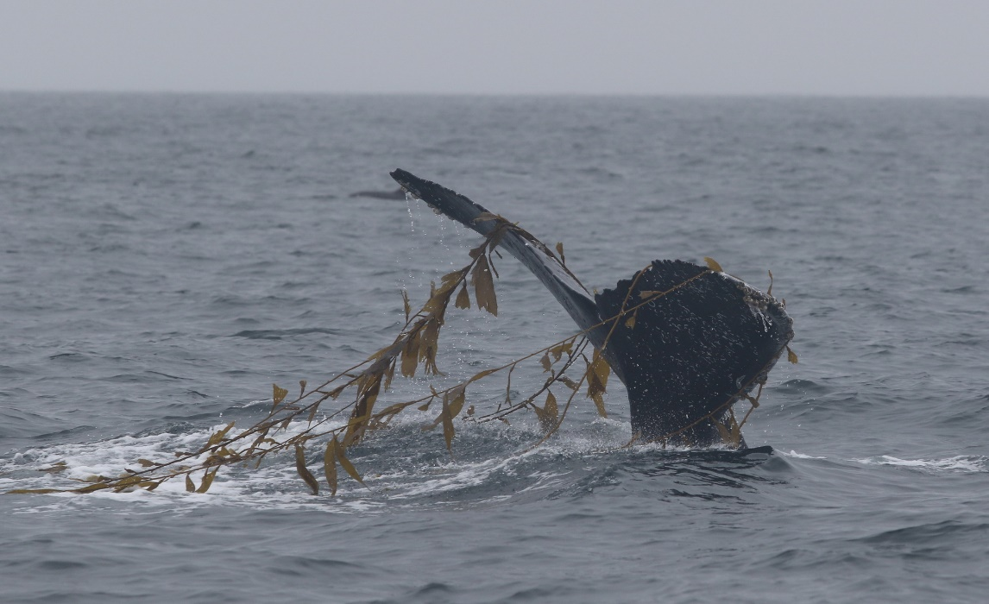
Interaction with gear: why do whales get entangled

Slide 32
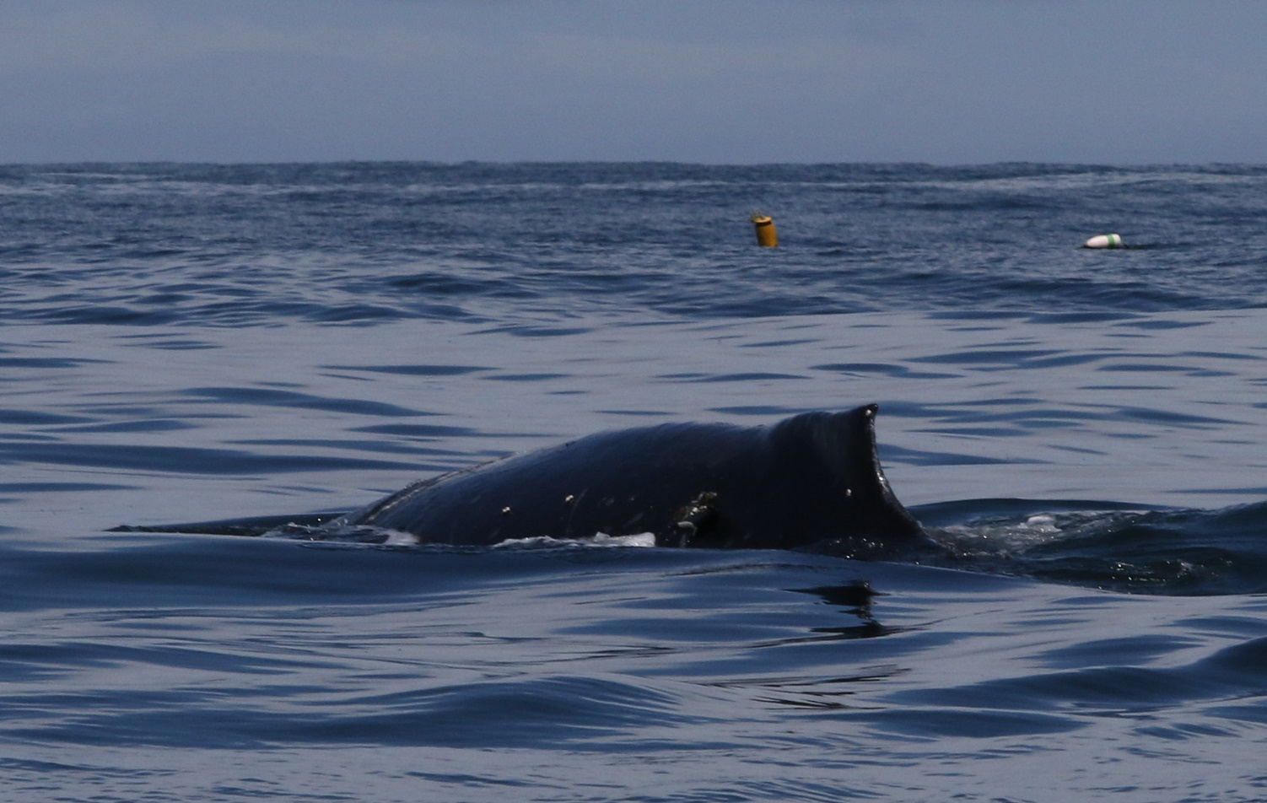
Tagged whale off HMB in May 2016

Slide 33
Blue whale abundance estimates - ENP

Slide 34
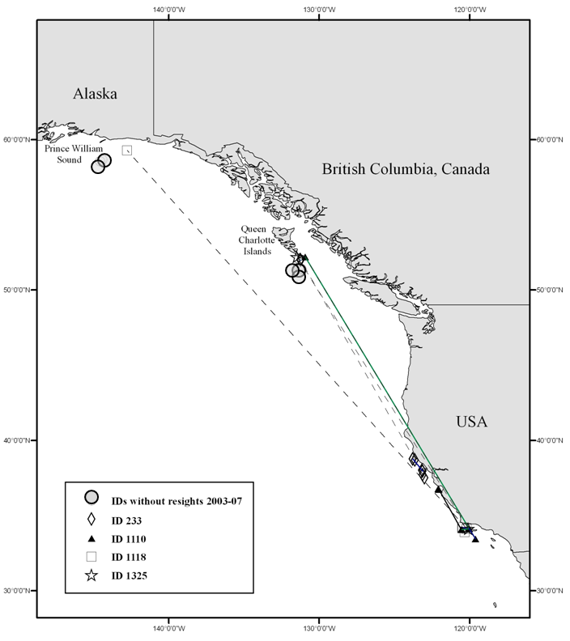
Eastern North Pacific Blue Whales
Return of blue whales to the B.C. coast and Gulf of Alaska included whales from California and likely related to the PDO shift to cold regime.
Calambokidis et al. (Submitted 2008)

Slide 35
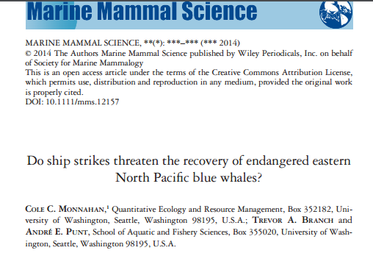
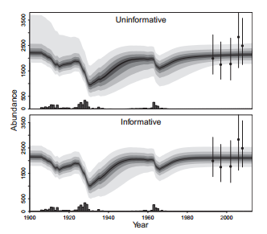
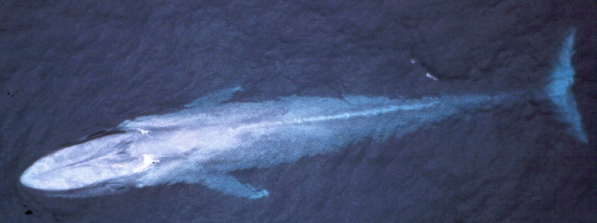
Blue whale population model and vulnerability

Slide 36
Conclusions
Changes in humpback whale status and management more accurately represent true status but present major challenges. Importance of management that emphasizes the feeding areas because:
  Most time spent there
  Most impacts occur on feeding grounds
  Humpback whales most loyal to feeding areas
Humpback whale distribution influenced by
  Wider distribution and longer periods on feeding areas as population hits carrying capacity
  Prey choice with krill near shelf edge and fish closer to shore
Whale interaction with gear likely partly a result of their tendency to interact with kelp and other objects

